Slide 1
CS 35L – Section 1
11/04/2013
Zhanyong Wang (Jerry)
zhanyongwang@ucla.edu
Office Hour:
9:00-11:00 Tuesday
BH 2432

Slide 2
SSH Setup And Use in Applications
Lab 6

Slide 3
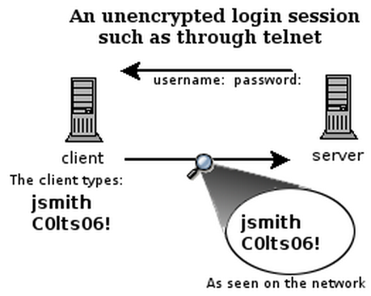
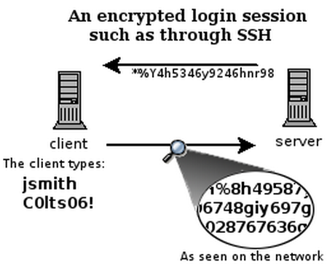
What is SSH?
Secure Shell
Used to remotely access shell
Successor of telnet
Encrypted and better authenticated session

Slide 4
Encryption Types
Symmetric Key Encryption
  a.k.a shared/secret key
  Key used to decrypt is the same as key used to encrypt
Asymmetric Key Encryption: Public/Private
  2 different (but related) keys: public and private
    Only creator knows the relation. Private key cannot be derived from public key
  Data encrypted with public key can only be decrypted by private key and vice versa
  Public key can be seen by anyone
  Never publish private key!!!

Slide 5
High-Level SSH Protocol
Client ssh’s to remote server
  $ ssh username@somehost
  If first time talking to server -> host validation
The authenticity of host 'somehost (192.168.1.1)' can't be established.
RSA key fingerprint is 90:9c:46:ab:03:1d:30:2c:5c:87:c5:c7:d9:13:5d:75.
Are you sure you want to continue connecting (yes/no)? yes
Warning: Permanently added 'somehost' (RSA) to the list of known hosts.
  ssh doesn't know about this host yet
  shows hostname, IP address and fingerprint of the server’s public key, so you can be sure you're talking to the correct computer
  After accepting, public key is saved in ~/.ssh/known_hosts

Slide 6
Host Validation
Next time client connects to server
  Check host’s public key against saved public key
  If they don’t match
$ ssh username@somehost
@@@@@@@@@@@@@@@@@@@@@@@@@@@@@@@
@ WARNING: REMOTE HOST IDENTIFICATION HAS CHANGED! @
@@@@@@@@@@@@@@@@@@@@@@@@@@@@@@@
IT IS POSSIBLE THAT SOMEONE IS DOING SOMETHING NASTY!
Someone could be eavesdropping on you right now (man-in-the-middle attack)!
It is also possible that the RSA host key has just been changed.
The fingerprint for the RSA key sent by the remote host is
90:9c:46:ab:03:1d:30:2c:5c:87:c5:c7:d9:13:5d:75.
Please contact your system administrator.
Add correct host key in /home/user/.ssh/known_hosts to get rid of this message.
Offending key in /home/user/.ssh/known_hosts:1
Password authentication is disabled to avoid man-in-the-middle attacks.
Agent forwarding is disabled to avoid man-in-the-middle attacks.
X11 forwarding is disabled to avoid man-in-the-middle attacks.
Permission denied (publickey,password,keyboard-interactive).

Slide 7
Host Validation (cont’d)
Client asks server to prove that it is the owner of the public key using asymmetric encryption
  Encrypt a message with public key
  If server is true owner, it can decrypt the message with private key
If everything works, host is successfully validated

Slide 8
Session Encryption
Client and server agree on a symmetric encryption key (session key)
All messages sent between client and server are first encrypted at the sender, and then decrypted at the receiver with that session key
anybody who doesn't know the session key (hopefully, anyone but the client and server) doesn't know any of the contents of those messages

Slide 9
Client Authentication
Password-based authentication
  Prompt for password on remote server
  If username specified exists and remote password for it is correct then the system lets you in
Key-based authentication
  Generate a key pair on the client
  Copy the public key to the server (~/.ssh/authorized_keys)
  Server authenticates client if it can demonstrate that it has the private key
  The private key can be protected with a passphrase
  Every time you ssh to a host, you will be asked for the passphrase (inconvenient!)

Slide 10
ssh-agent (passphrase-less ssh)
A program used with OpenSSH that provides a secure way of storing the private key
ssh-add prompts user for the passphrase once and adds it to the list maintained by ssh-agent
Once passphrase is added to ssh-agent, the user will not be prompted for it again when using SSH
OpenSSH will talk to the local ssh-agent daemon and retrieve the private key from it automatically

Slide 11
X Window System
Windowing system that forms the basis for most GUIs on UNIX
X is a network-based system. It is based upon a network protocol such that a program can run on one computer but be displayed on another (X Session Forwarding)

Slide 12
Lab 6
Securely log in to each others’ computers
  Use ssh (OpenSSH)
Use key-based authentication
  Generate key pairs (ssh-keygen)
Make logins convenient
  type your passphrase once and be able to use ssh to connect to any other host without typing any passwords or passphrases
Use port forwarding to run a command on a remote host that displays on your monitor

Slide 13
Lab Environment Setup
Ubuntu
  Make sure you have openssh-server and openssh-client installed
  $ dpkg --get-selections | grep openssh should output:
    openssh-server install
    openssh-client install
  If not:
    $ sudo apt-get install openssh-server
    $ sudo apt-get install openssh-client

Slide 14
How to SSH to Each Other
Server
    Generate public and private keys
      $ ssh-keygen (by default saved to ~/.ssh/is_rsa and id_rsa.pub)
    Create an account for the client on the server
      $ sudo useradd –d /home/username –m UserName
      $ sudo passwd UserName
    Create .ssh directory for new user
      $ cd /home/username
      $ sudo mkdir .ssh
    Change ownership and permission on .ssh directory
      $ sudo chown –R username .ssh
      $ sudo chmod 700 .ssh

Slide 15
How to SSH to Each Other
Client
    Generate public and private keys
      $ ssh-keygen
    Copy your public key to the server (~/.ssh/authorized_keys)
      $ ssh-copy-id –i UserName@server_ip_addr
    Add privte key to authentication agent (ssh-agent)
      $ ssh-add
    SSH to server
      $ ssh UserName@server_ip_addr
      $ ssh –X UserName@server_ip_addr (X11 session forwarding)
    Run a command on the remote host
      $ xterm, $ gedit, $ firefox, etc.

Slide 16
How to Check IP Addresses
$ ifconfig
  configure or display the current network interface configuration information (IP address, etc.)
$ ping <ip_addr>(packet internet groper)
  Test the reachability of a host on an IP network
  measure round-trip time for messages sent from a source to a destination computer
  Example: $ ping 192.168.0.1, $ ping google.com

